Slide 1
Software Testing Market Survey Making a 10-min mp4 with Powerpoint!
Assignment
by Farn Wang
Submission deadline 2020/03/25

Slide 2
Goal - So that you have an idea about the opportunities in software QA and testing market
Please submit a PPT ppsx file (recording file) by March 25, 2020.
In your ppsx, your should analyze the following issues.
Global revenue in one year, including in-house and out-sourcing to test services.
Growth momentum and trend of the software testing industry.
Market value of testing tools for web, Android, iOS apps.
Market value of testing service companies in one year.
Functionalities of testing tools for web, Android, iOS apps.

Slide 3
Goal
Some useful links:
https://www.technavio.com/research/software-testing-market
Top 10 tools:
https://medium.com/@briananderson2209/best-automation-testing-tools-for-2018-top-10-reviews-8a4a19f664d2
Many Selenium plugins are not free. A mobile version of Selenium is Appium.
Top 50 in 2019:
https://www.guru99.com/testing-tools.html
Top 20 in 2019:
https://www.softwaretestinghelp.com/top-20-automation-testing-tools/
Top 20 testing services in 2019:
https://www.softwaretestinghelp.com/software-testing-service-providers/

Slide 4

Step 1
How to make ppsx file ?
(1/9)

Slide 5
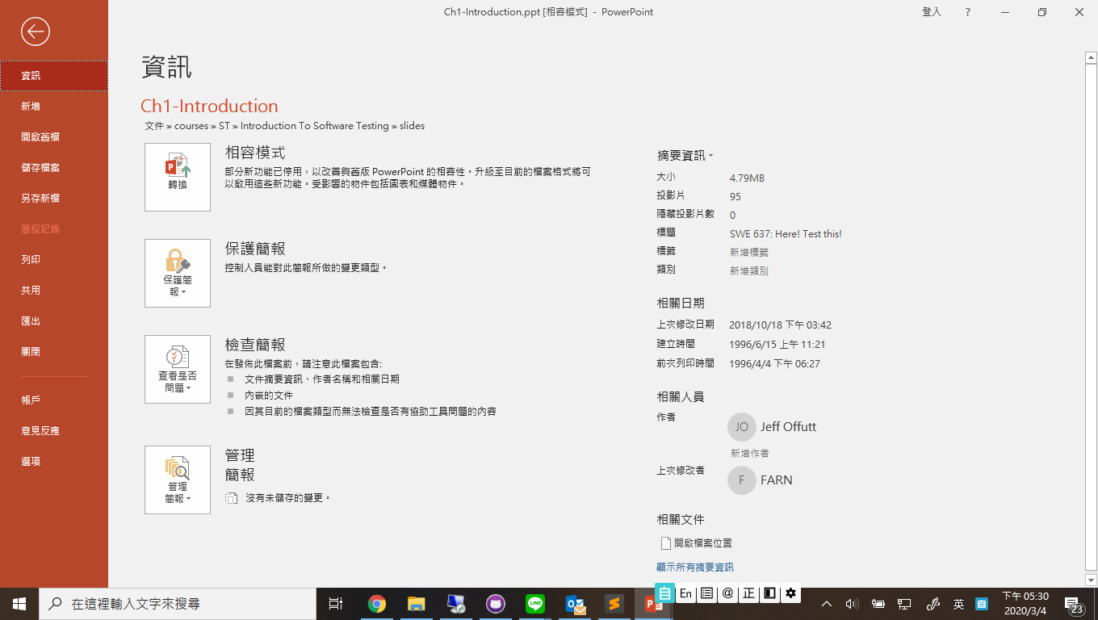
How to make ppsx file ?
(2/9)
Step 2

Slide 6
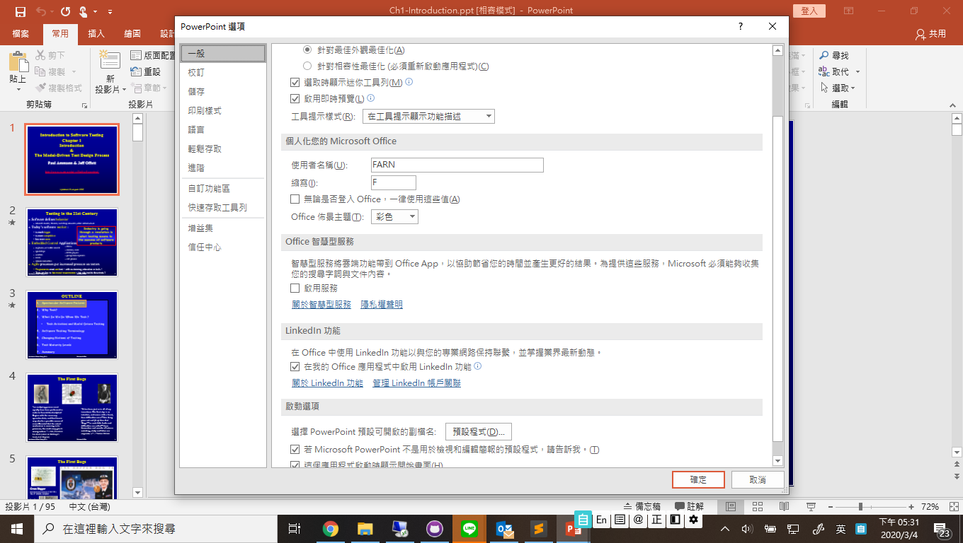
How to make ppsx file ?
(3/9)
Step 3

Slide 7
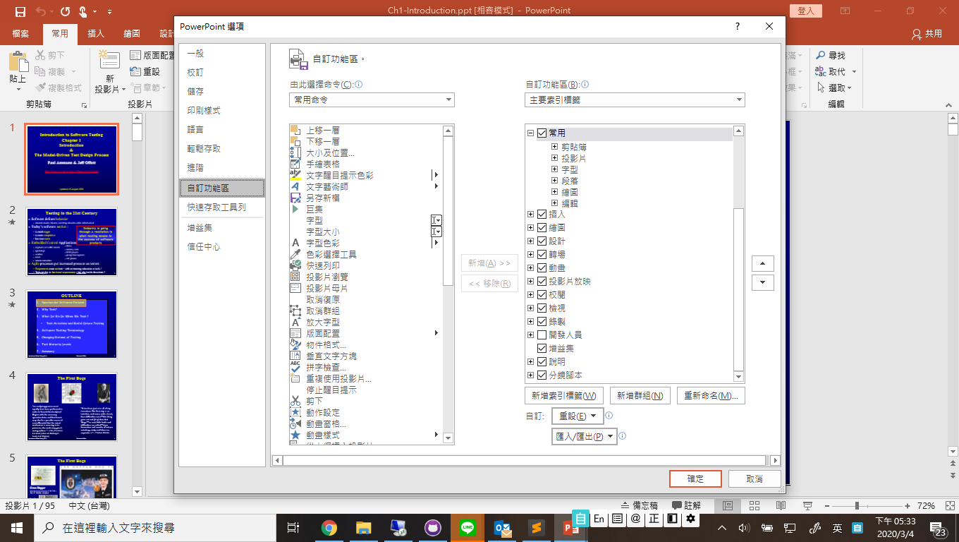
How to make ppsx file ?
(4/9)
Step 4
Step 5

Slide 8

Step 6
How to make ppsx file ?
(5/9)

Slide 9

How to make ppsx file ?
(6/9)
Step 7

Slide 10
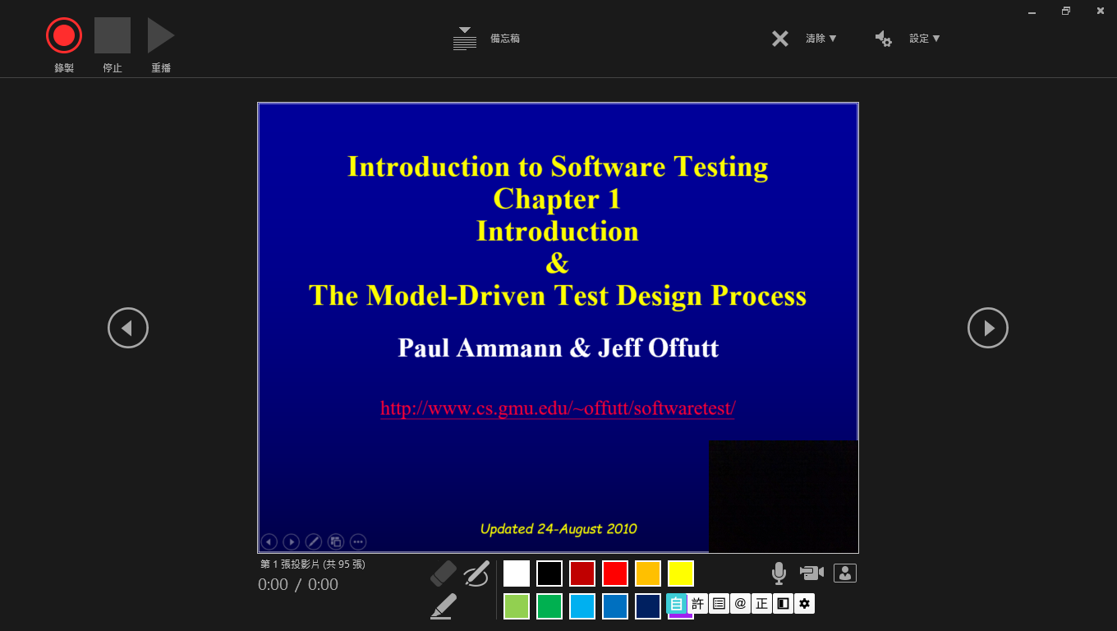
Step 9
How to make ppsx file ?
(7/9)
Step 8

Slide 11
How to make ppsx file ?
(8/9)
Step 10: Generate mp4!
Step 9:
Generate
ppsx!

Slide 12
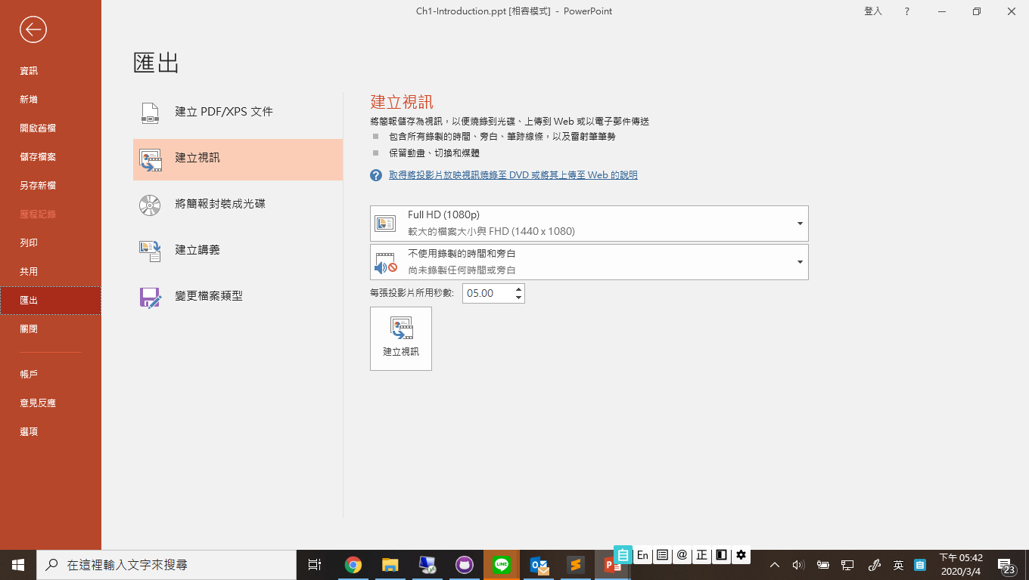
How to make ppsx file ?
(9/9)
Step 11

